Slide 1
kickzsoccer: Club services Kickzsoccer Club Services
“YEAR ROUND TRAINING SERVICE PROVIDER”
Official Equipment Provider
In association with

Slide 2
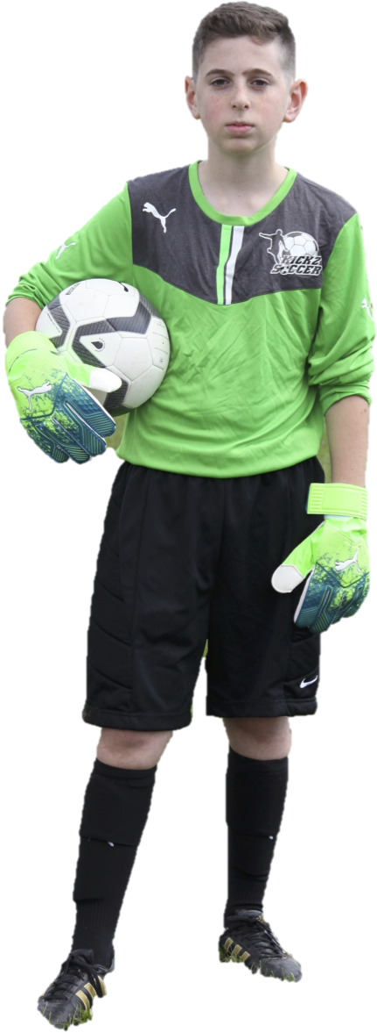
Table of Contents ”what can we offer your soccer club”
About Us: See Slide 3.
Team Training Services: See Slides 4-5.
Lesson Plan Samples: See Slide 6.
Skill Builder Training: See Slide 7.
Tryout Support Services: See Slide 8.
Seasonal Summer Camps: See Slide 9.
Pre-Travel Support: See Slide 10.
Recreational Program Support: See Slide 12.
Sample Curriculum: See Slide 13.
First11 Academy Program: See Page 14.
Request more information: See Page 15.
Contact US!: See Page 16.
www.kickzsoccer.com

Slide 3
About Us
PROFESSIONAL: A professional soccer coaching organization that is dedicated to providing players of all ages and abilities an opportunity to advance their skills and knowledge of the game in a safe and professional learning environment.
EXPERIENCE: over 15 years of experience supporting; Soccer Clubs, Travel Teams, Townships, Schools and Recreational programs across NJ, NY & PA.
US BASED STAFF: Full time US-Based professional coaching staff that possess extensive playing and coaching experience, combined with a background in teaching. All members of staff possess recognized coaching licenses, such as USSF, NSCAA, FA or equivalent with a minimum of 3 years coaching and teaching experience.
YEAR ROUND: The ability to offer year round training support, which allows for unrivaled continuity for both teams and players with our professional US-based coaches and administrative support staff.
FULL SERVICE: With a wide range of programs and services, Kickzsoccer is able to meet the ongoing needs of your club, teams and players.
www.kickzsoccer.com

Slide 4
Team Training Services “YEAR ROUND TRAINING SUPPORT”
Seasonal Training
Weekly Team Training Sessions
Game Day Coaching / Support Services
Customizable Team Training Curriculum
Flexible Training Schedules to meet your needs
Supplemental Training
Goal-scoring Sessions (All Ages)
Technical Training (All Ages)
Goalkeeping Sessions (All Ages)
Club Support Services
Tryout Support Services (Seasonal)
Coaches Clinics / Recreation Support / Curricula
Seasonal Camps & Programs (Indoor / Outdoor)
www.kickzsoccer.com

Slide 5
Team Training INFORMATION “A Structured Team Training Program can be the difference between success and failure"
All teams will be assigned a CERTIFIED and EXPERIENCED member of our coaching staff that will oversee weekday practices and game-day support (optional) for the season.
Kickzsoccer staff will provide a structured and progressive training curriculum designed to meet the individual needs of each team on a seasonal basis.
Team curriculum will be developed to include TECHNICAL, TACTICAL, PHYSICAL and PSYCHOLOGICAL areas of the game.
CONTINUITY is assured, with all sessions delivered by the same trainer on a weekly basis at the soccer clubs desired facility.
Teams will have access to their assigned trainer for camps and programs during the off-season, providing YEAR-ROUND support
www.kickzsoccer.com

Slide 6
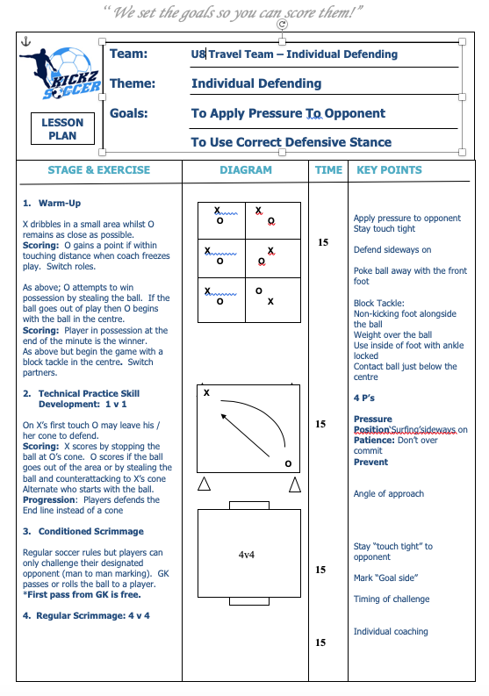
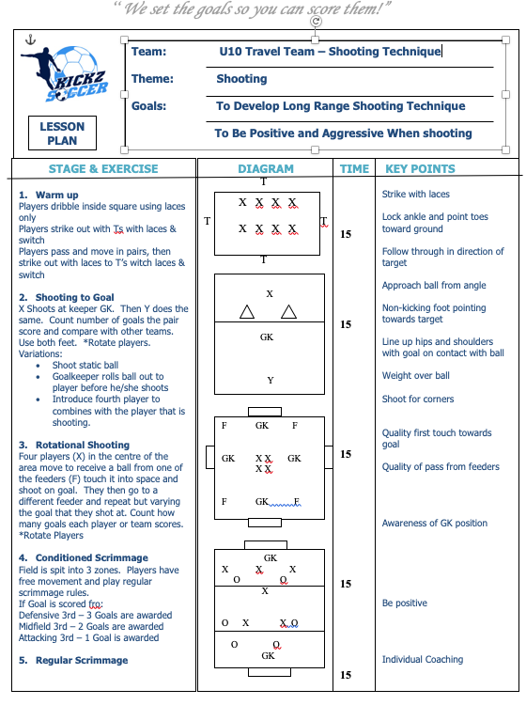
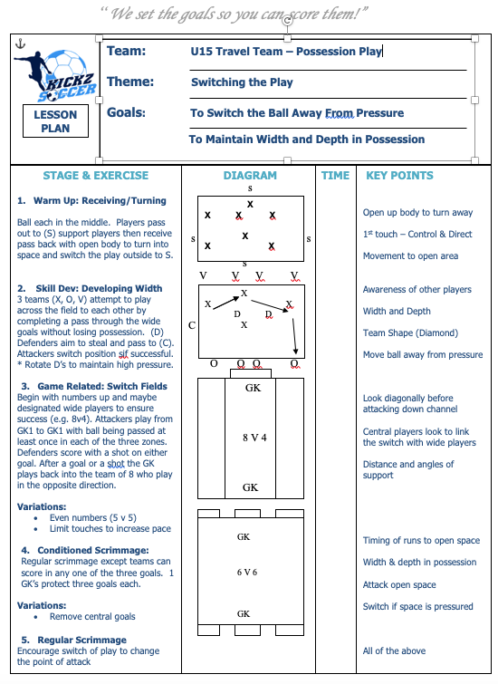
lesson plan samples “age appropriate curriculum”
www.kickzsoccer.com

Slide 7
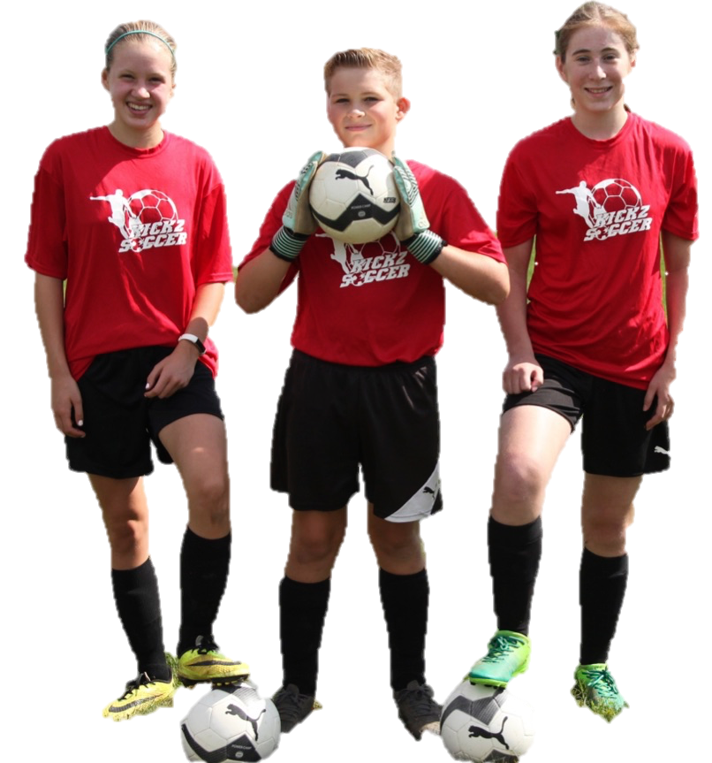
Skill Builder Training "SUPPLEMENTAL PLAYER CLINICS”
GOAL-SCORING Ages 6-15
Helps enrich players who are looking to improve their goal scoring ability and become more confident in front of goal. Sessions will include instruction on techniques such as; shooting, finishing, heading, receiving and 1v1 moves.
GOALKEEPING Ages 6-15
Used to advance goalkeepers ability and knowledge by developing the four dimensions of goalkeeping; technical, tactical, physical and mental. Providing players the opportunity to learn the specifics GOALEEPING.
DRILLS 4 SKILLS AGES 6-15
Designed to supplement the individual player in their quest to improve their technical ball skills, confidence & fitness with our unique age-specific curriculum. This program will challenge players in every technical aspect required to raise their game to the next level.
BALL MASTERY Ages 6-15
Focuses on individual ball control, touch, technique and co-ordination to encourage confidence in possession. Areas such as; dribbling, receiving, individual possession, passing and 1v1 play will be developed during the course of the program.
Note: Programs run weekly for both small & full-sided players for 1hr+ sessions. Flexible schedules available to maximize player attendance
www.kickzsoccer.com

Slide 8
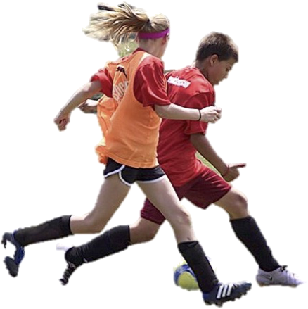
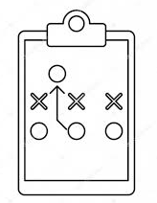
Tryout Support Services “player evaluation support”
Let Kickzsoccer evaluate one of the toughest and most important tasks of the season, Tryouts! Our knowledgeable coaching staff will run and evaluate tryouts designed to simulate "real- game" situations where players will be evaluated and ranked according to our detailed player evaluation process. Tryouts will be held at a facility of your choice with multiple weekday and weekend schedules available to suit your needs. Take the stress out of your tryout process this season!
Proven Method as used by Professional Academies
Professional Qualified Staff will oversee evaluations
Presentation to ensure Club Objectives are Met
Field Equipment & Evaluation Materials provided
Detailed Evaluation and Ranking Procedures
Player Registration and evaluation forms provided
Full administration support provided (optional)
4v4+
1v1
2v1
Small-Sided Technical Tactical Evaluation 4v4 Drills 1v1 Drills Drills 2v1+ Support
www.kickzsoccer.com

Slide 9
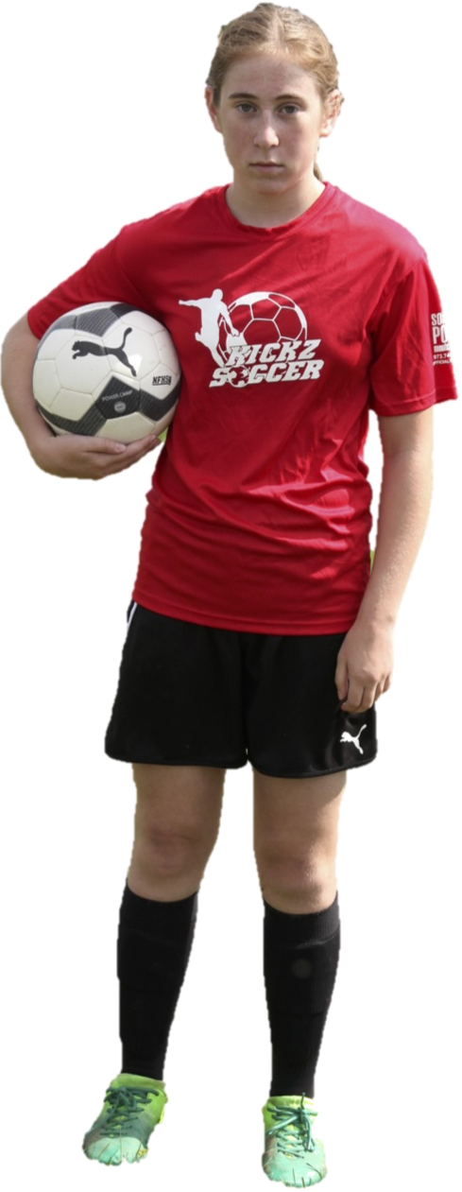
Seasonal Summer Camps “Team & PLAYER Camps Available”
Team Camps Day/Evening (All ages).
Customizable Curriculum Designed to target areas of weakness and development.
Technical, Tactical and S.A.Q (Speed Agility & Quickness) Topics available.
Practice Scrimmages to develop player positioning and team formation.
Player Camps; World Cup Camp (Ages 6-15)
A fun and educational camp that introduces players to various soccer skills and 1v1 moves from around the world within drills, games & small-sided scrimmages
Players develop SKILL such as dribbling, passing & shooting based on a daily theme that relates to its country. Example: Brazil Day = Dribbling Techniques.
Players put these skills to the test in daily scrimmages to improve TECHNICAL and TACTICAL decision making in a fun and competitive environment against other campers
Pre-K Camp Kiddy Kickz (Ages 3-5)
This program is a unique soccer experience that combines children's general interests and familiar characters with fun soccer related activities
Ball each activities designed to help players to perform basic soccer skills and fundamentals in a safe and enjoyable learning environment.
www.kickzsoccer.com

Slide 10
Pre-travel SOCCER PROGRAMS
“A FUN INTRODUCTION TO SOCCER”
Kiddy Kickz Pre-K Camp (Ages 3-4)
Our soccer enrichment programs are designed to provide players an entry level opportunity to learn the fundamentals of the game in a safe and enjoyable environment.
These activities are designed to engage the players into performing basic soccer skills and fundamentals, providing an excellent introduction and head start towards their soccer careers.
Drills 4 Skills (Ages 5-7)
Designed to help the individual player in their quest to improve their technical ball skills, confidence & fitness with our unique age-specific curriculum.
This program will challenge players in every technical aspect required to raise their game to the next level.
Speed of execution & decision-making are also areas of focus to ensure skills are performed efficiently as well as effectively on the field.
www.kickzsoccer.com

Slide 11
Request more information
Interested in finding out more about kicksoccer?
presentation
Contact Kickzsoccer to schedule your presentation.
A member of our staff will meet with your board members at a time and location of your choice
Training demonstration
Why not experience our training first hand with a member of our coaching staff?
Kickzsoccer will send a trainer to run a practice with your players at a time & location convenient for you!
Phone / Email
Simply email or call our office for more information
www.kickzsoccer.com

Slide 12
Contact Kickzsoccer
GENERAL ENQUIRIES
CLUB SERVICES
EMAIL:
EMAIL:
Info@kickzsoccer.com
Garethchitticks@kickzsoccer.com
PHONE:
PHONE:
Office: (973) 452 5826
Office: (973) 270 7542
MAILING ADDRESS:
Kickzsoccer LLC
137 Mountain Avenue, Unit 3
Hackettstown, NJ, 07840
Copyright © 2012 Kickzsoccer. All Rights Reserved.
www.kickzsoccer.com

