Slide 1
kickzsoccer: recreation services Kickzsoccer Recreation Services
“we set the goals, so you can score them”
Official Equipment Provider
In association with

Slide 2
About Us
PROFESSIONAL: A professional soccer coaching organization that is dedicated to providing players of all ages and abilities an opportunity to advance their skills and knowledge of the game in a safe and professional learning environment.
EXPERIENCE: 15 years of experience supporting; Soccer Clubs, Travel Teams, Townships, Schools and Recreational programs across NJ, NY & PA.
US BASED STAFF: Full time US-Based professional coaching staff that possess extensive playing and coaching experience, combined with a background in teaching. All members of staff possess recognized coaching licenses, such as USSF, NSCAA, FA or equivalent with a minimum of 3 years coaching experience.
YEAR ROUND: The ability to offer year round training support, which allows for unrivaled continuity for both teams and players with our professional US-based coaches and administrative support staff.
FULL SERVICE: With a wide range of programs and services, Kickzsoccer is able to meet the ongoing needs of your club, teams and players.
www.kickzsoccer.com

Slide 3
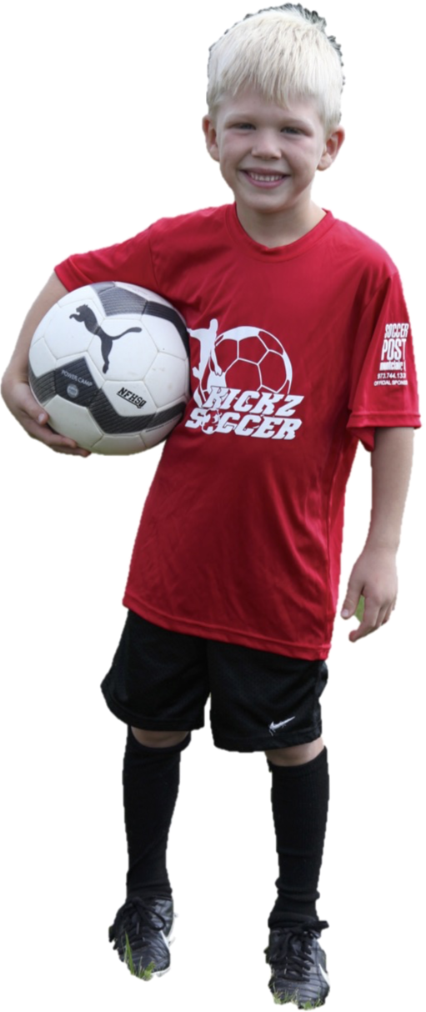
Recreational Program Support
“SPRING & FALL SEASONS / AGES 6-15YRS”
Our recreational soccer program provides young soccer players the opportunity to develop their skills and knowledge of the game, in a fun and enjoyable learning environment that better prepares them for the demands of travel soccer with our age appropriate curriculum.
Kickzsoccer will work directly with your club to provide a tailored program designed to meet the needs of your club and design a structured curriculum with these principles in mind. Our recreation programs will include the following modules:
Module 1: Technique: Structured curriculum designed to develop the key fundamentals of the game
Module 2: Laws of the Game: Instruction & implementation of the Laws of the game on a weekly basis
Module 3: Skill Moves: Introduction to basic 1v1 skill moves to improve 1v1 play
Example of a typical 6-week curriculum for age groups K through 8th Grade.
Week 1 - Dribbling
Week 2 – Passing
Week 3 – Receiving
Week 4 – 1v1 Defending
Week 5 – 1v1 Attacking
Week 6 – Shooting
www.kickzsoccer.com

Slide 4
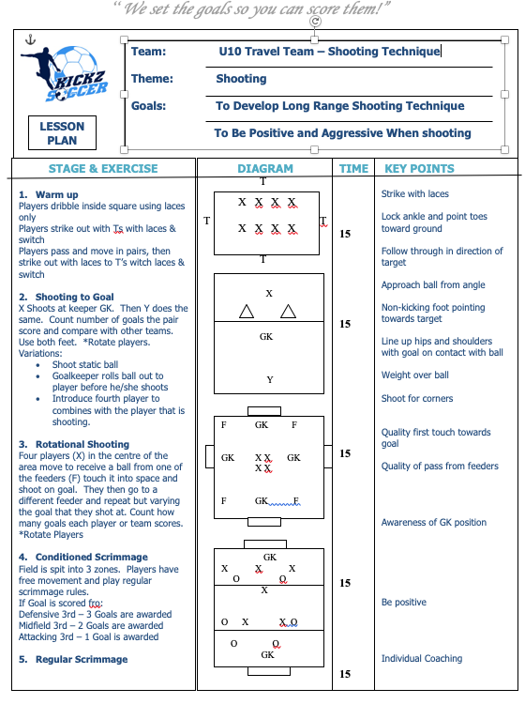
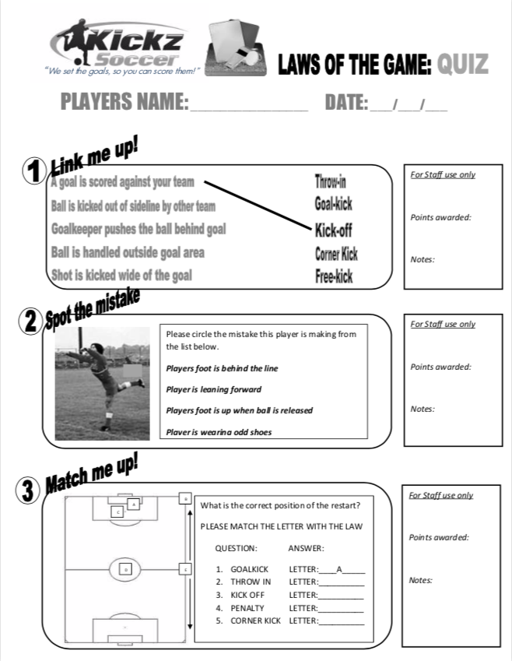
Sample Curriculum
8 WEEK SAMPLE CURRICULUM
Weekly Lesson Plans Designed to develop basic fundamentals &techniques (all ages)
1v1 Skill Moves Introducing basic skills moves; scissors, step over each week
Laws of the Game Quiz time to review laws of the game in a fun way to aid learning
www.kickzsoccer.com

Slide 5
kickzsoccer: soccer clinics Kickzsoccer Club Services
“we set the goals, so you can score them”
Official Equipment Provider
In association with

Slide 6
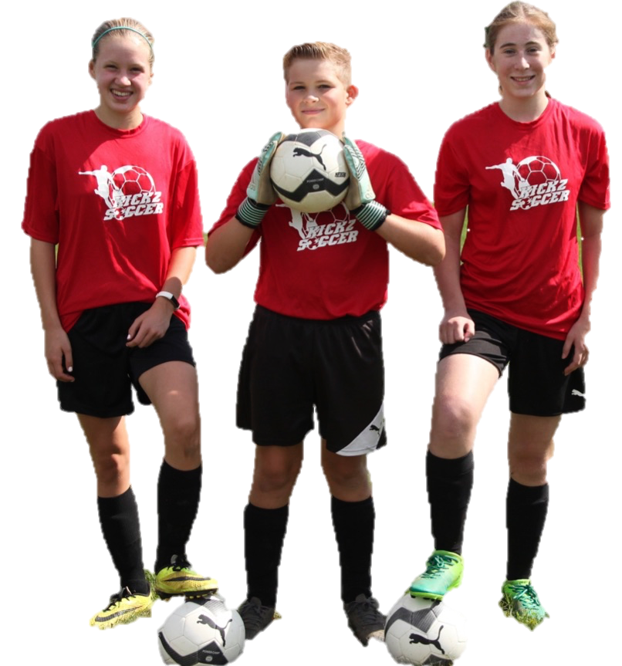
Skill Builder CLINICS
“let us create a fun soccer program for your recreation department”
GOAL-SCORING Ages 6-15
Helps enrich players who are looking to improve their goal scoring ability and become more confident in front of goal. Sessions will include instruction on techniques such as; shooting, finishing, heading, receiving and 1v1 moves.
GOALKEEPING Ages 6-15
Used to advance goalkeepers ability and knowledge by developing the four dimensions of goalkeeping; technical, tactical, physical and mental. Providing players the opportunity to learn the specifics of GK.
DRILLS 4 SKILLS AGES 6-15
Designed to supplement the individual player in their quest to improve their technical ball skills, confidence & fitness with our unique age-specific curriculum. This program will challenge players in every technical aspect required to raise their game to the next level.
BALL MASTERY Ages 6-15
Focuses on individual ball control, touch, technique and co-ordination to encourage confidence in possession. Areas such as; dribbling, receiving, individual possession, passing and 1v1 play will be developed during the course of the program.
Note: Programs run weekly for both small & full-sided players for 1hr+ sessions. Flexible schedules available to maximize player attendance
www.kickzsoccer.com

Slide 7
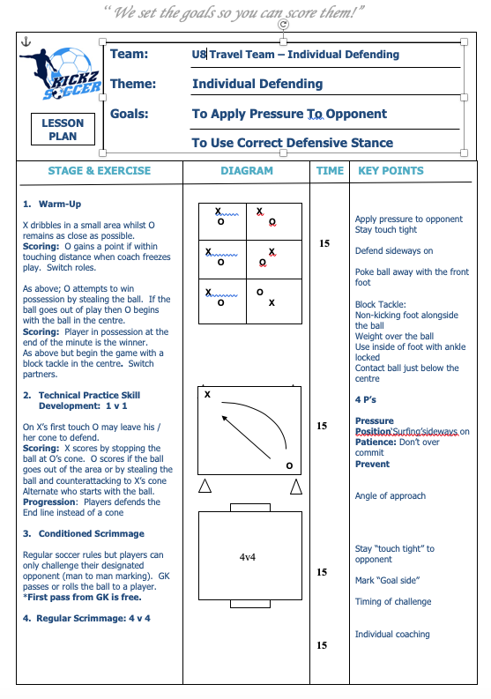
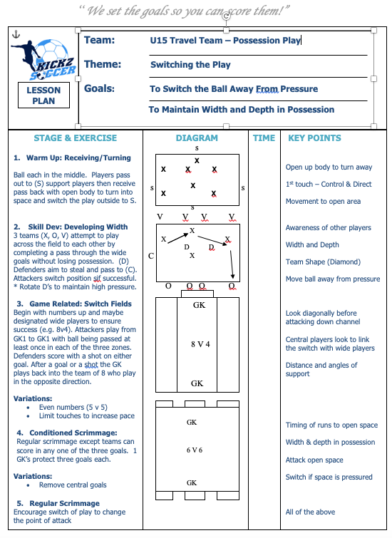
lesson plan samples “age appropriate curriculum”
www.kickzsoccer.com

Slide 8
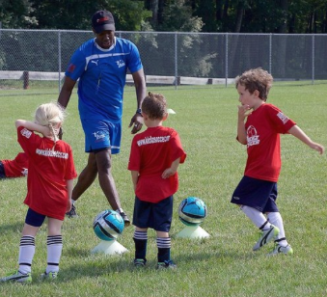
PRE-K SOCCER CLINICS
“A FUN INTRODUCTION TO SOCCER FOR PLAYERS 3-5YRS
PRE-K SOCCER Ages 3-5
A FUN introduction to soccer in a safe and enjoyable environment. A unique soccer experience that combines children’s general interests and hobbies with fun soccer related activities. These activities are designed to engage player into performing basic soccer skills and fundamentals, providing them an excellent introduction and head start towards their soccer careers.
Sessions would run weekly either on a weekday and/or weekday for 1 hour sessions at a field and location convenient to you and your participants.
Gender split optional
30 MINUTE SESSIONS ALSO AVAILABLE
www.kickzsoccer.com

Slide 9
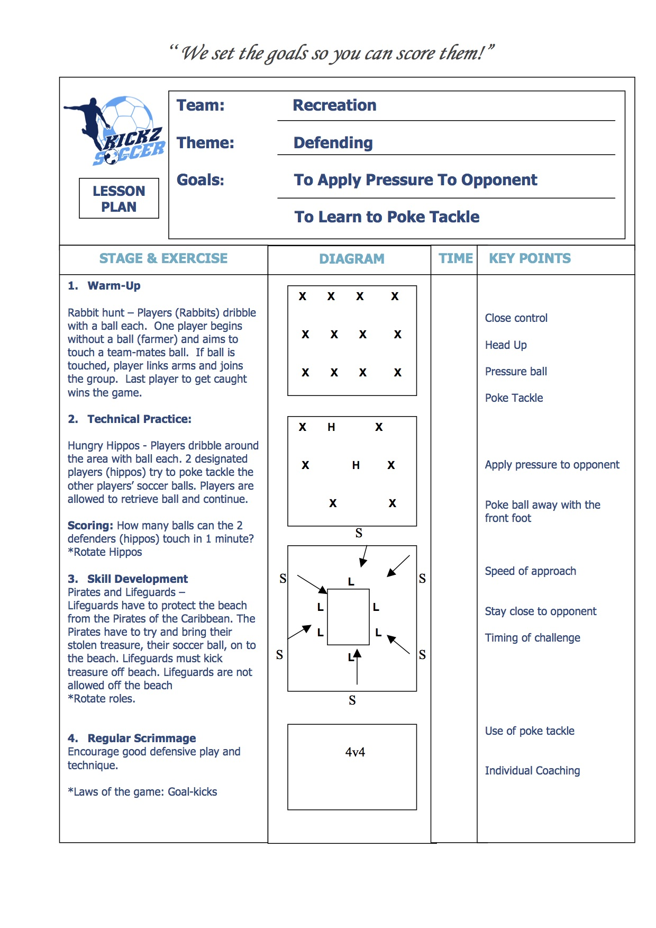
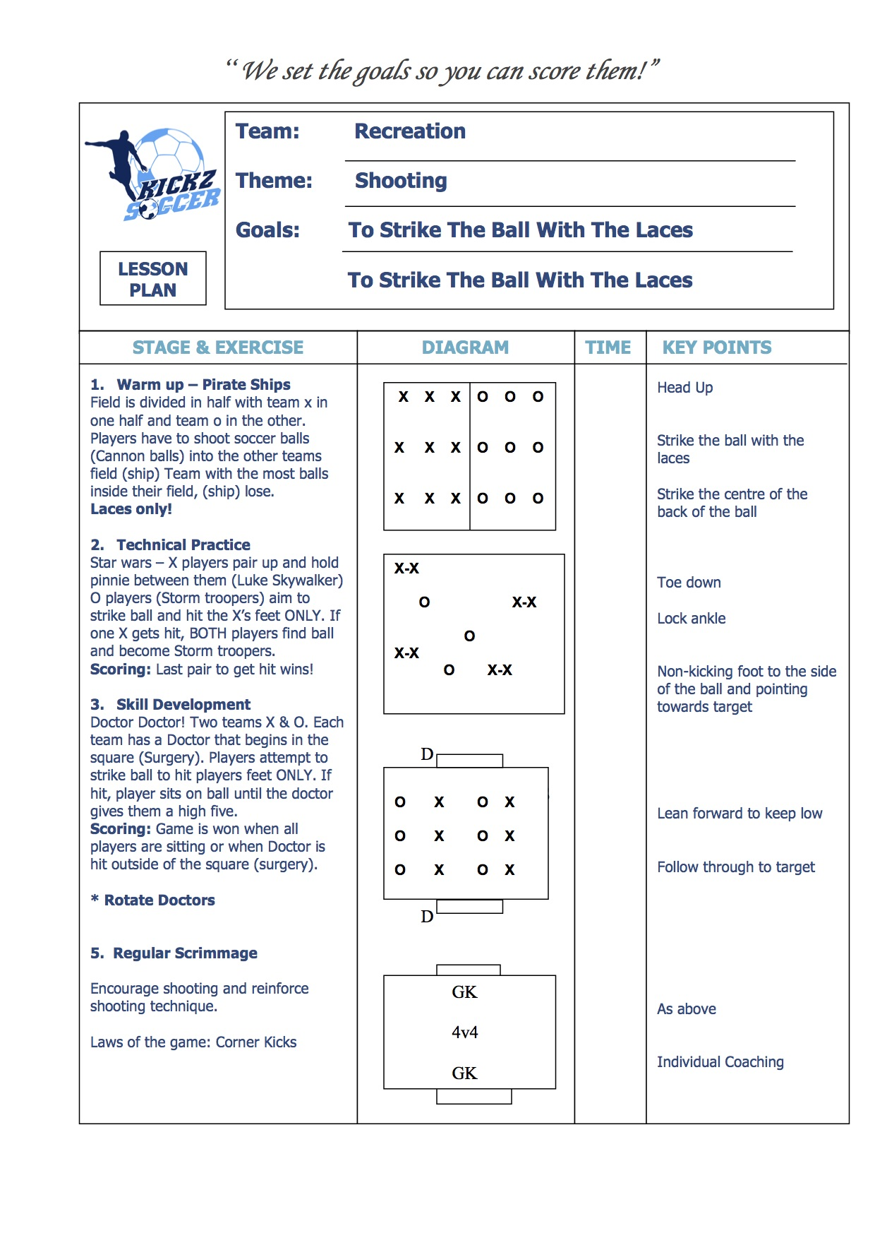
lesson plan samples “learn skills thru fun games”
www.kickzsoccer.com

Slide 10
kickzsoccer: soccer camps Kickzsoccer Club Services
“we set the goals, so you can score them”
Official Equipment Provider
In association with

Slide 11
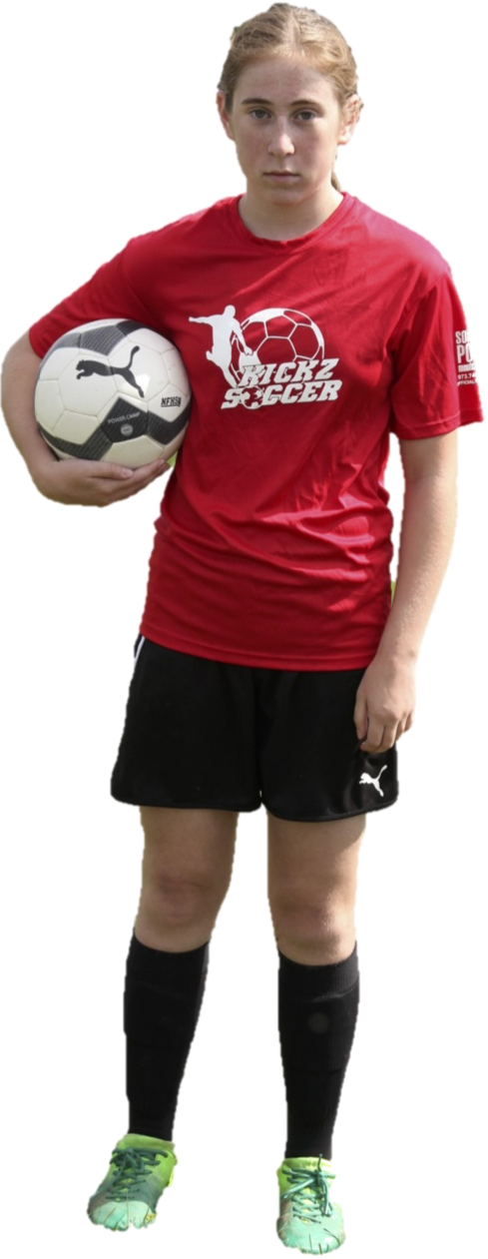
Seasonal Summer Camps “PLAYERS AGES 3-15YRS OF ALL LEVELS”
Player Camps; World Cup Camp (Ages 6-15)
A fun and educational camp that introduces players to various soccer skills and 1v1 moves from around the world within drills, games & small-sided scrimmages
Players develop SKILL such as dribbling, passing & shooting based on a daily theme that relates to its country. Example: Brazil Day = Dribbling Techniques.
Players put these skills to the test in daily scrimmages to improve TECHNICAL and TACTICAL decision making in a fun and competitive environment against other campers
Kiddy Kickz Pre-K Camp (Ages 3-5)
This program is a unique soccer experience that combines children's general interests and familiar characters with fun soccer related activities
Ball each activities designed to help players to perform basic soccer skills and fundamentals in a safe and enjoyable learning environment.
Day and Evening Camps available during the summer at your fields!
www.kickzsoccer.com

Slide 12
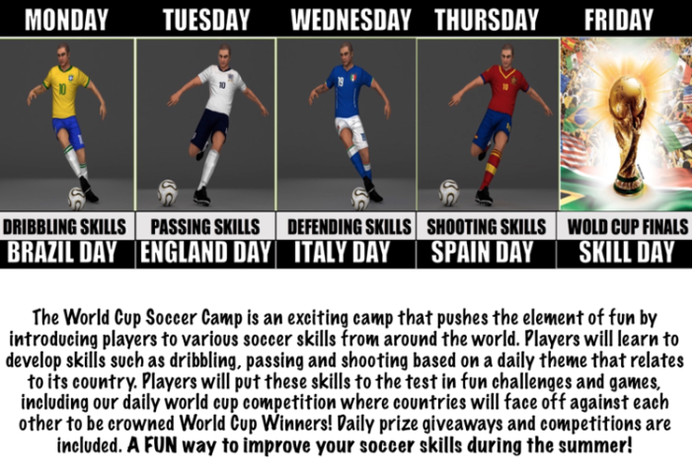
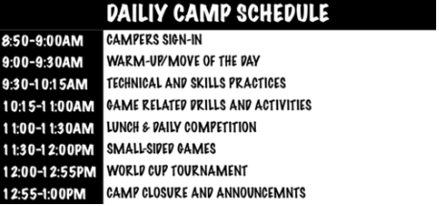
world cup soccer camp “learn skills from around the world”
Evening camps schedules available
FREE camp tees and merchandise provided
www.kickzsoccer.com

Slide 13
Request more information
Interested in finding out more about kicksoccer?
presentation
Contact Kickzsoccer to schedule your presentation.
A member of our staff will meet with your board members at a time and location of your choice
Training demonstration
Why not experience our training first hand with a member of our coaching staff?
Kickzsoccer will send a trainer to run a practice with your players at a time & location convenient for you!
Phone / Email
Simply email or call our office for more information
www.kickzsoccer.com

Slide 14
Contact Kickzsoccer
GENERAL ENQUIRIES
CLUB SERVICES
EMAIL:
EMAIL:
Info@kickzsoccer.com
Garethchitticks@kickzsoccer.com
PHONE:
PHONE:
Office: (973) 884 6069
Office: (973) 270 7542
MAILING ADDRESS:
Kickzsoccer LLC
137 Mountain Avenue, Unit 3
Hackettstown, NJ, 07840
Copyright © 2012 Kickzsoccer. All Rights Reserved.
www.kickzsoccer.com

